Slide 1
Automated Cricket Pitch Covers

Slide 2
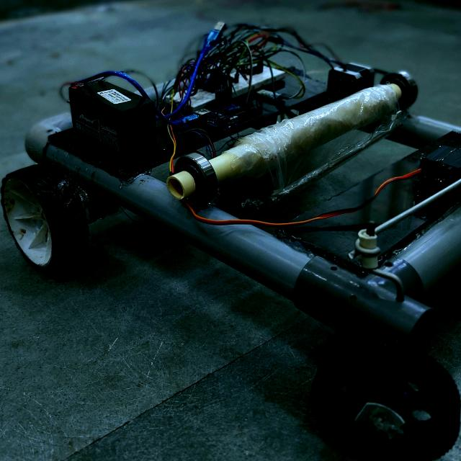
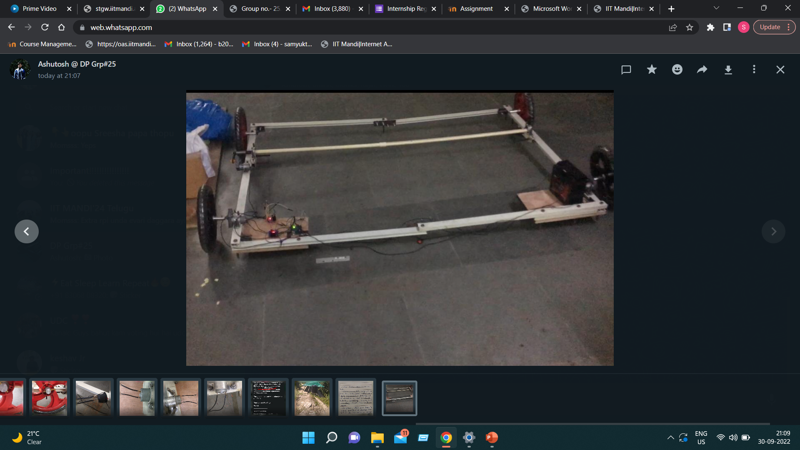
Introduction
Automated pitch covering model operated by android application
Objective of the model is to reduce large man-power and guarantees the scalability of the model.

Slide 3
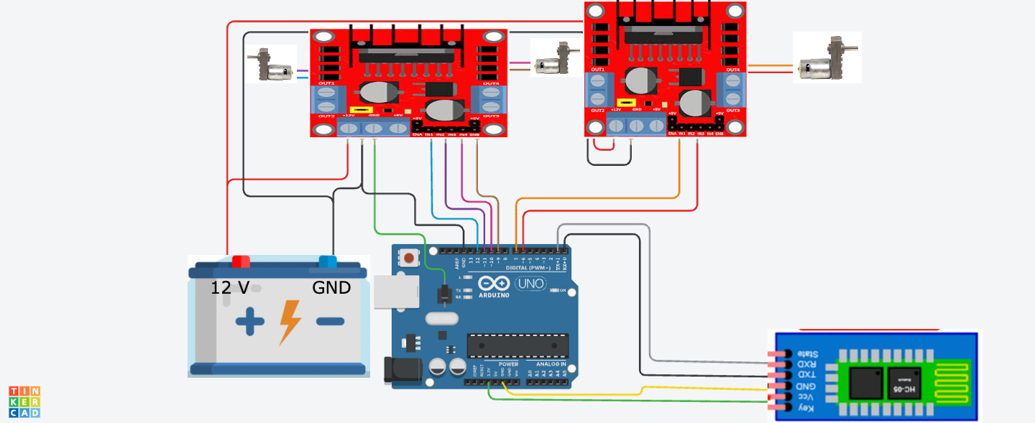
Circuit design

Slide 4
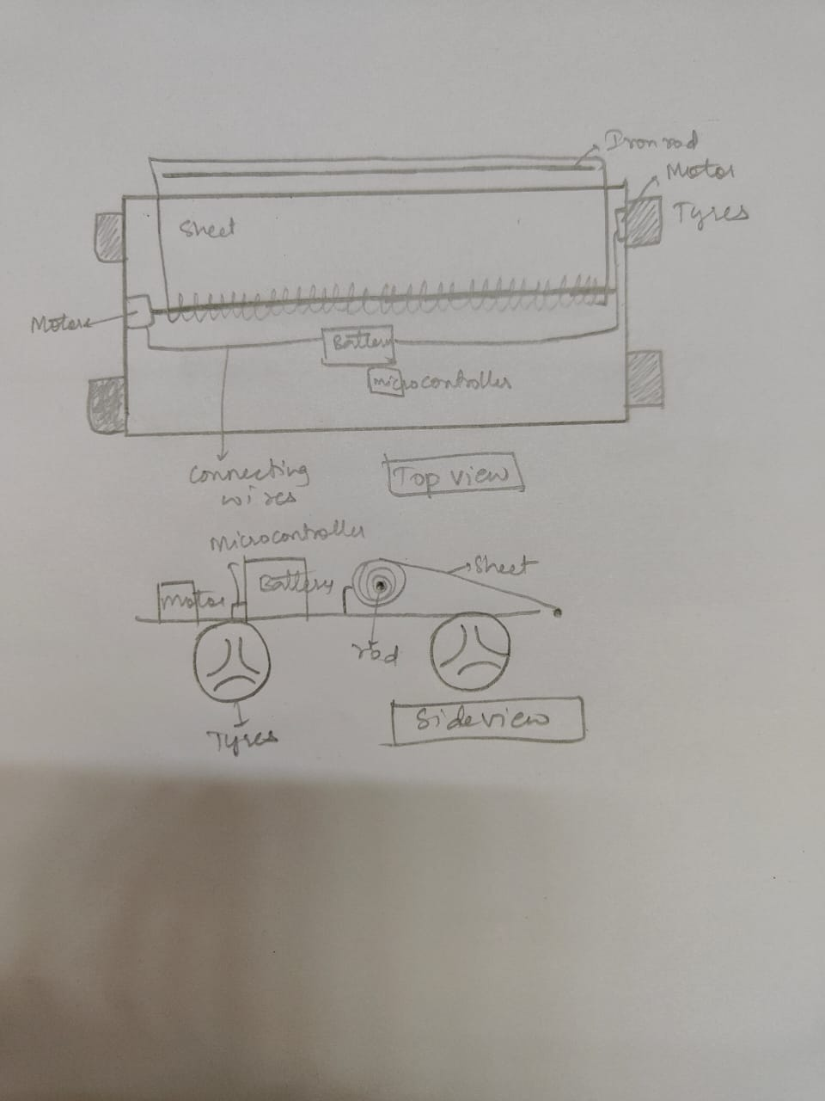
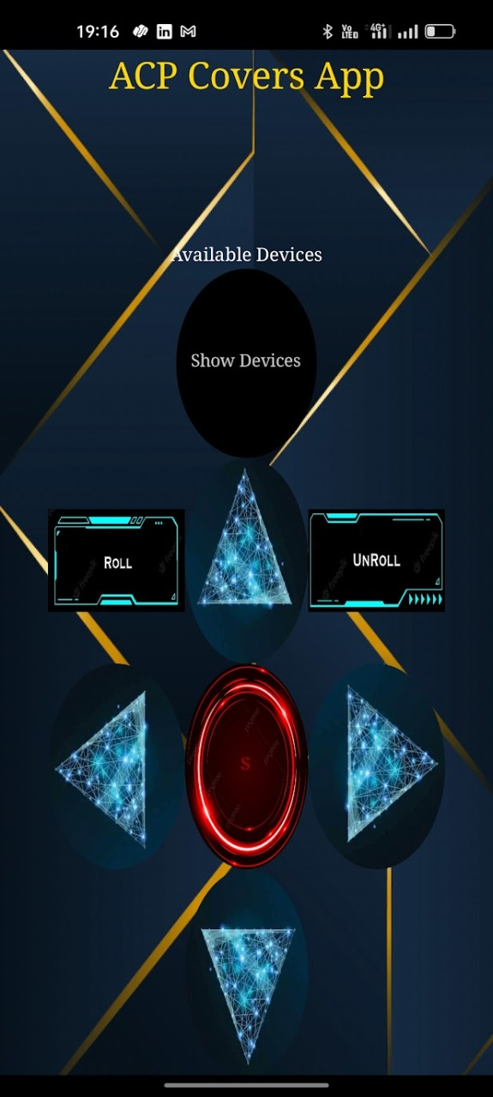
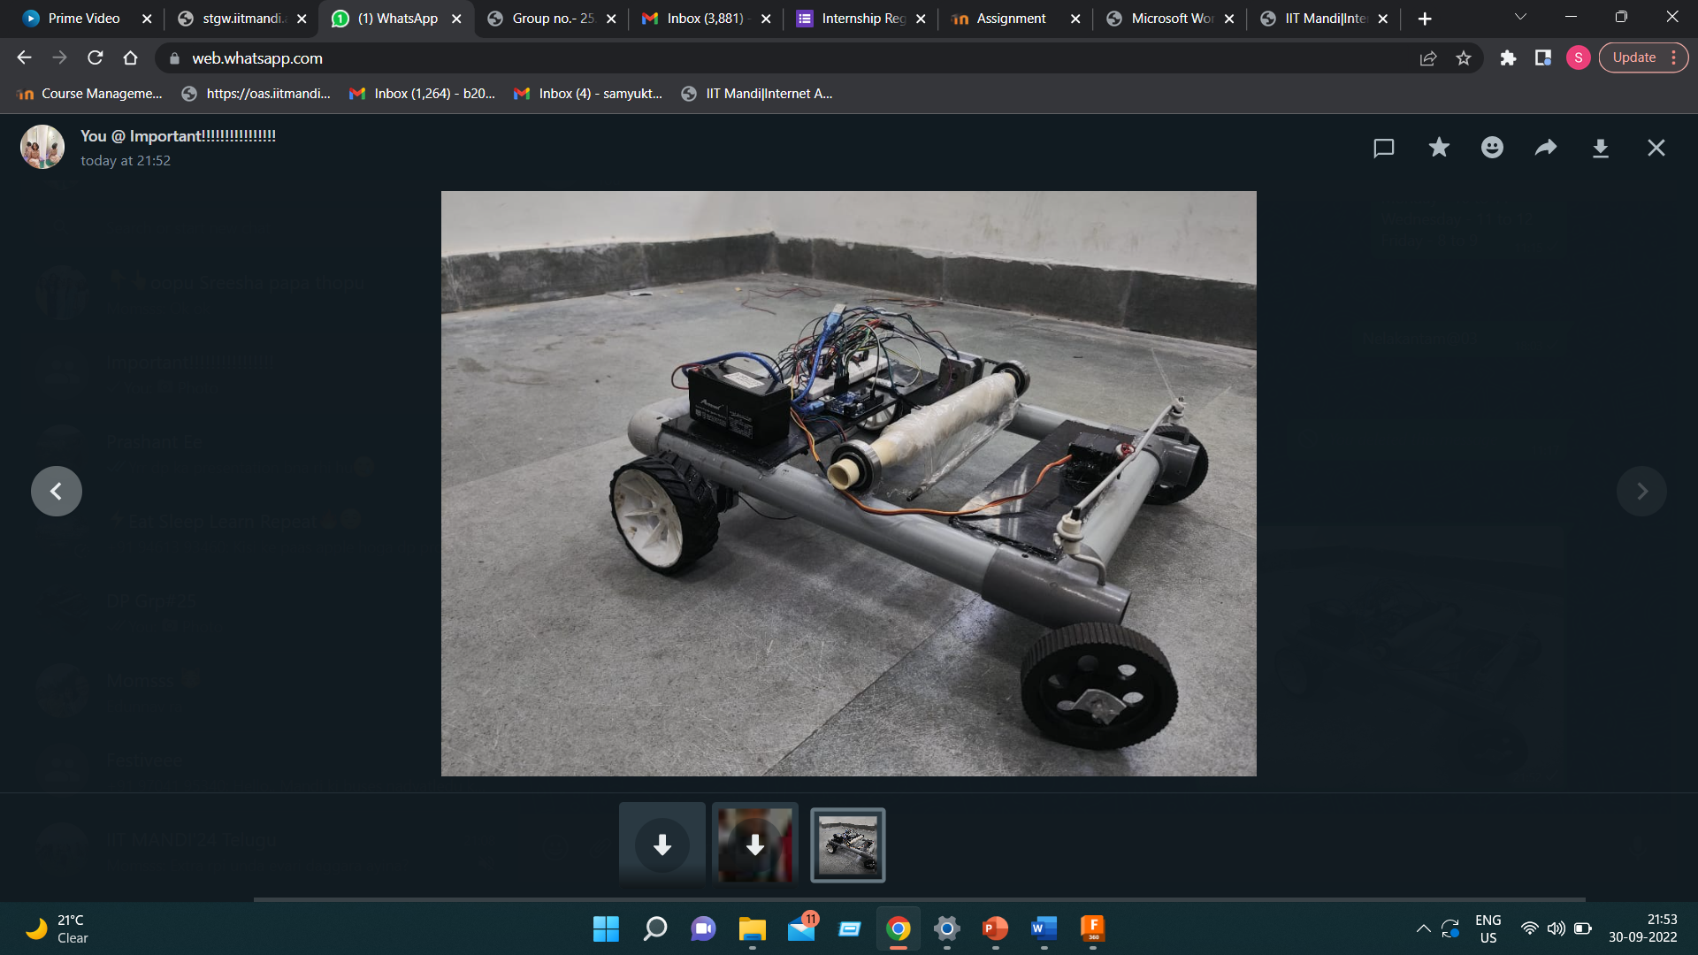
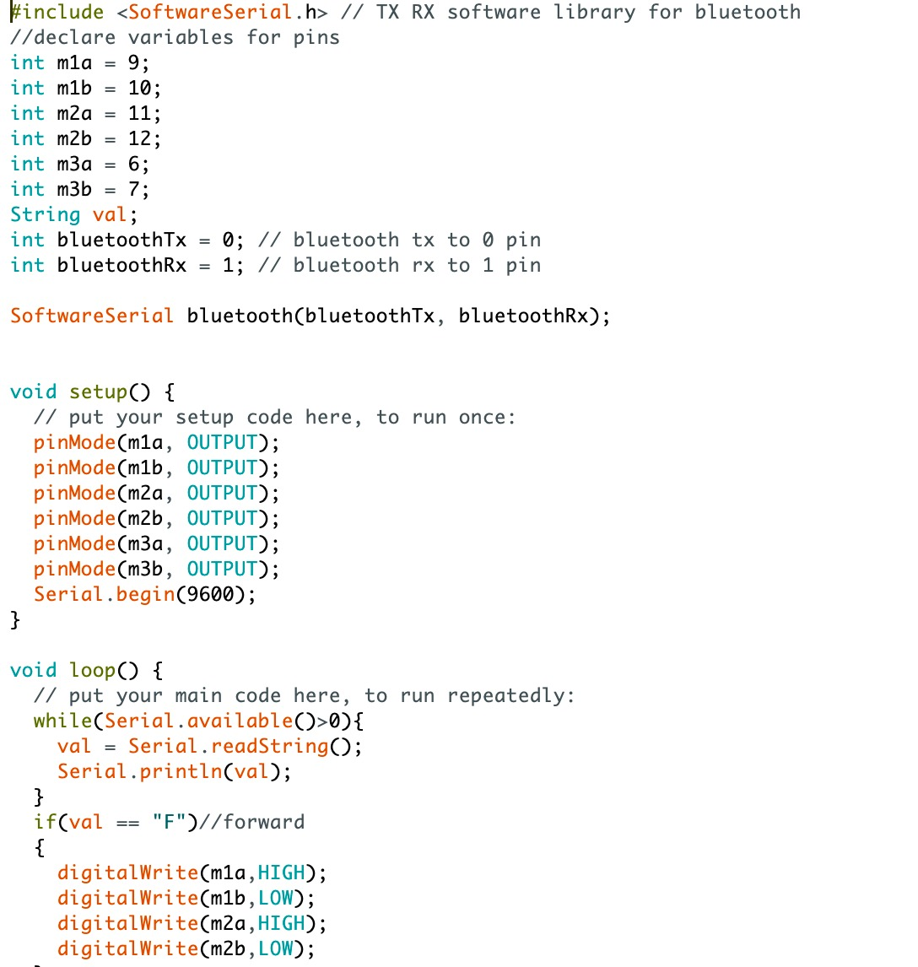
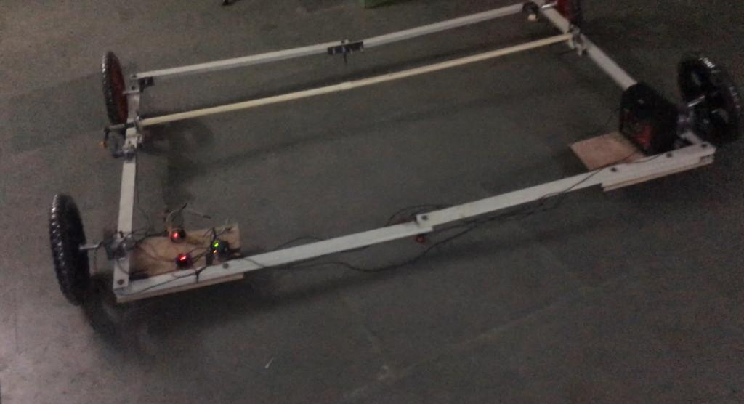
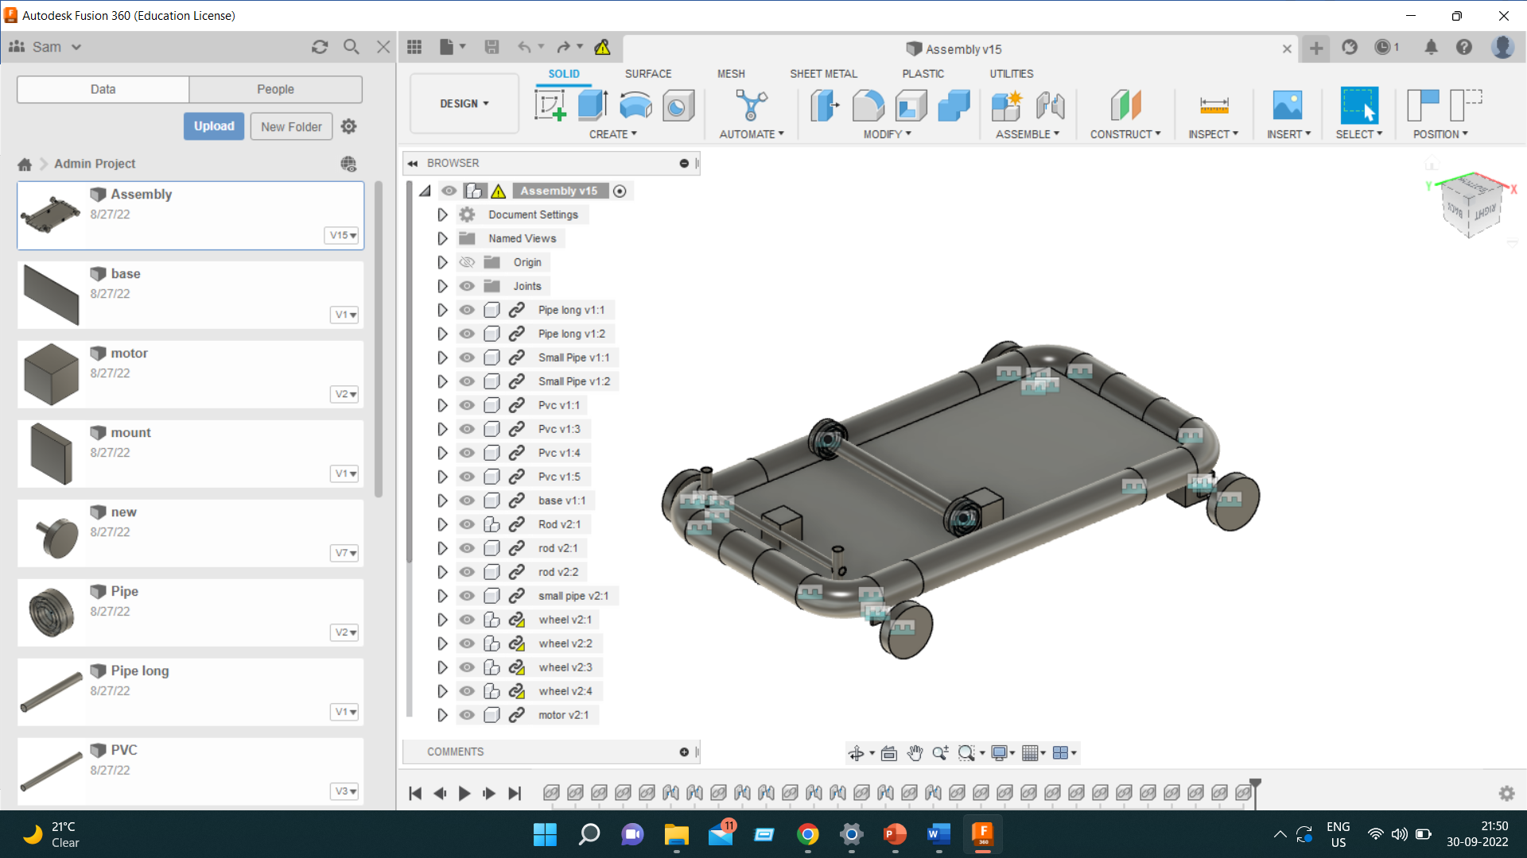
Timeline flowchart
2D Design
Cad model
prototype designing
Code
Android App
Final model designing

Slide 5
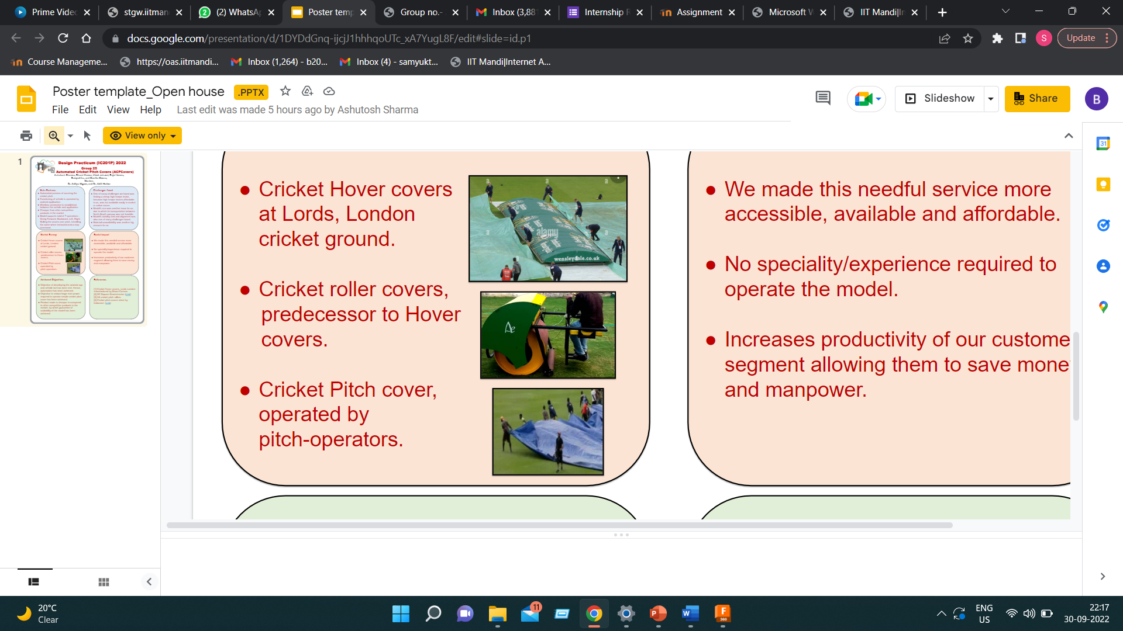
Impact and scope
Motivation to do this project is to automate or advance the technology of protecting cricket pitch from rain so we combined the idea of Hover covers and Rollers covers.
We made this needful service more accessible, available and affordable.

